Slide 1
Chapter 3:
LINEAR MOTION

Slide 2
Objectives of this lecture:
Motion Is Relative
Speed : Average and Instantaneous
Velocity: Constant and Changing
Acceleration
Free Fall
Hang Time

Slide 3

Motion Is Relative
Motion of objects is always described as relative to something else. For example:
You walk on the road relative to Earth, but Earth is moving relative to the Sun.
So your motion relative to the Sun is different from your motion relative to Earth.

Slide 4
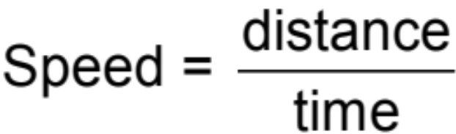
Speed
Defined as the distance covered per amount of travel time.
Units are meters per second.
In equation form:
Example: A man runs 3 meters in 2 sec. His speed is 1.5 m/s.

Slide 5

Average Speed
The entire distance covered divided by the total travel time
  Does not indicate various instantaneous speeds along the way.
In equation form:
Example: When you drive a distance of 200 km in 2 h, your average speed is 100 km/h.

Slide 6
The average speed of driving 30 km in 1 hour is the same as the average speed of driving
30 km in 1/2 hour.
30 km in 2 hours.
60 km in 1/2 hour.
60 km in 2 hours.

Slide 7
The average speed of driving 30 km in 1 hour is the same as the average speed of driving
30 km in 1/2 hour.
30 km in 2 hours.
60 km in 1/2 hour.
60 km in 2 hours.
Explanation:
Average speed = total distance / time
So, average speed = 30 km / 1 h = 30 km/h.
Same
Now, if we drive 60 km in 2 hours:
Average speed = 60 km / 2 h = 30 km/h

Slide 8
Instantaneous Speed
Instantaneous speed is the speed at any instant.
Example:
  When you ride in your car, you may speed up and slow down.
  Your instantaneous speed is given by your speedometer.

Slide 9
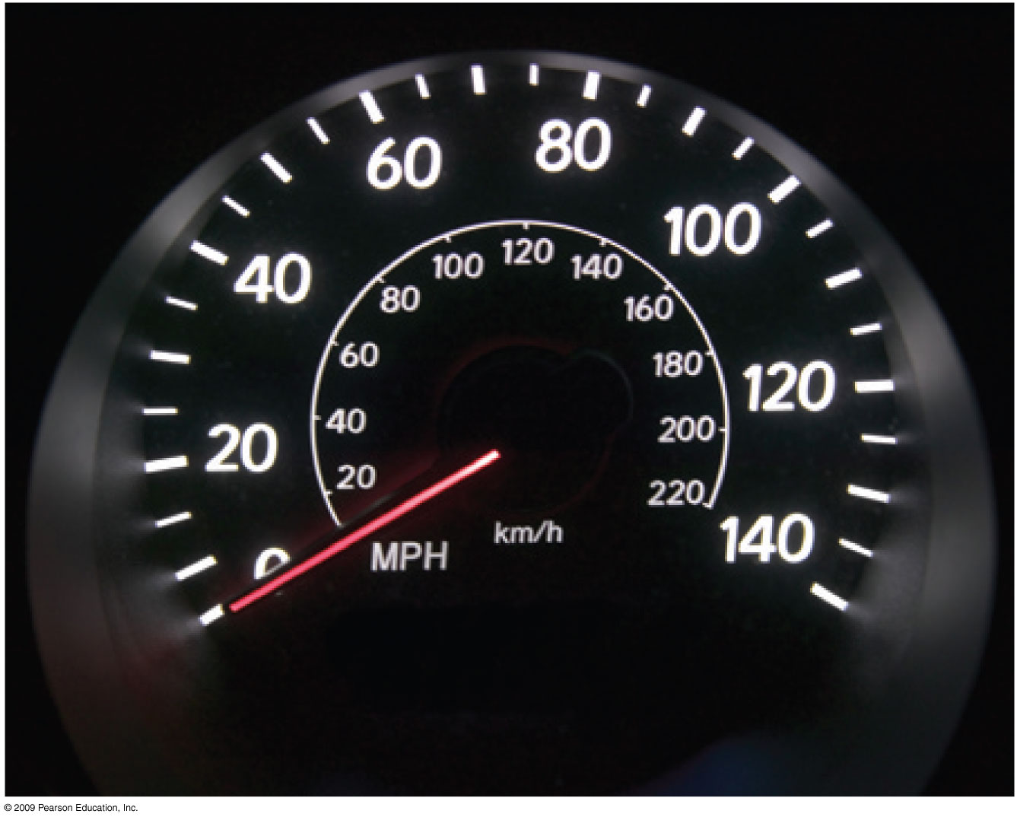
Figure 3.2

Slide 10
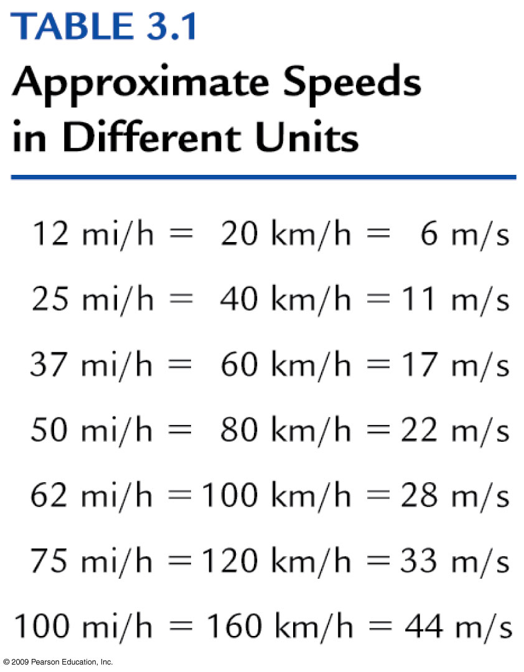
Table 3.1

Slide 11
Velocity
A description of
  the instantaneous speed of the object AND
  what direction the object is moving
Velocity is a vector quantity. It has
  magnitude: instantaneous speed
  direction: direction of object’s motion

Slide 12
Speed and Velocity
Constant speed is steady speed, neither speeding up nor slowing down.
Constant velocity is
  constant speed and
  constant direction (straight-line path with no acceleration).
Motion is relative to Earth, unless otherwise stated.

Slide 13
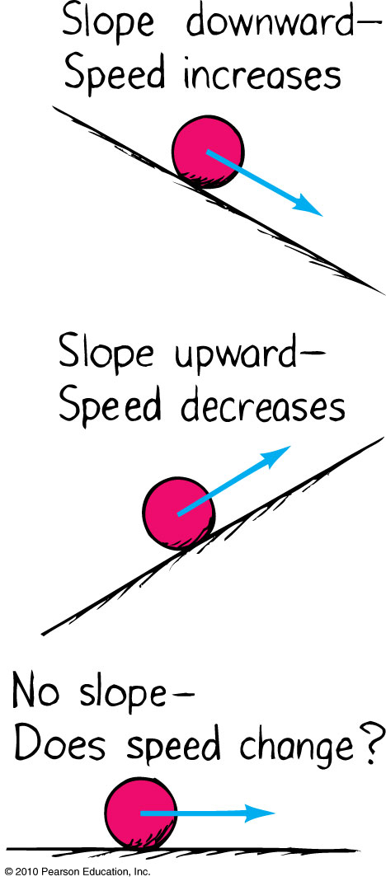
Acceleration
Formulated by Galileo based on his experiments with inclined planes.
Acceleration is the rate at which velocity changes over time.

Slide 14

Acceleration
Involves a
change in speed, or
change in direction, or
both.
Example: Car making a turn

Slide 15

Acceleration
In equation form:
Unit of acceleration is unit of velocity / unit of time.
Example:
You car’s speed right now is 40 km/h.
Your car’s speed 5 s later is 45 km/h.
Your car’s change in speed is 45 – 40 = 5 km/h.
Your car’s acceleration is 5 km/h/5 s = 1 km/hs.

Slide 16
What is the acceleration of a race car that passes you at a constant velocity of
300km/s ?
300 km/s²
zero
150 km/s²
None of the above

Slide 17
What is the acceleration of a race car that passes you at a constant velocity of
300km/s ?
300 km/s²
zero
150 km/s²
None of the above
Explanation: because velocity doesn’t change.

Slide 18
Acceleration and velocity are actually
the same.
rates but for different quantities.
the same when direction is not a factor.
the same when an object is freely falling.

Slide 19
Acceleration and velocity are actually
the same.
rates but for different quantities.
the same when direction is not a factor.
the same when an object is freely falling.
Explanation:
Velocity is the rate at which distance changes over time,
Acceleration is the rate at which velocity changes over time.

Slide 20
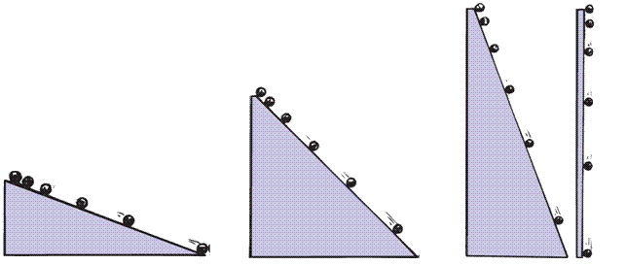
Acceleration
Galileo increased the inclination of inclined planes.
Steeper inclines gave greater accelerations.
When the incline was vertical, acceleration was max, same as that of the falling object.
When air resistance was negligible, all objects fell with the same unchanging acceleration.

Slide 21
Free Fall
Falling under the influence of gravity only - with no air resistance
Freely falling objects on Earth accelerate at the rate of 10 m/s² (more precisely, 9.8 m/s²).

Slide 22
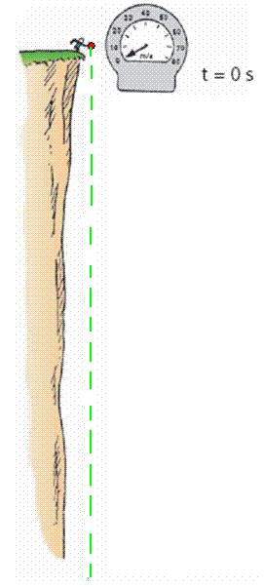
Free Fall—How Fast?
The velocity acquired by an object starting from rest is
V = g t
So, under free fall, when acceleration is 10 m/s², the speed is
10 m/s after 1 s.
20 m/s after 2 s.
30 m/s after 3 s.
And so on.

Slide 23
A free-falling object has a speed of 30 m/s at one instant. Exactly 1 s later its speed will be
the same.
35 m/s.
more than 35 m/s.
60 m/s.

Slide 24
A free-falling object has a speed of 30 m/s at one instant. Exactly 1 s later its speed will be
the same.
35 m/s.
more than 35 m/s.
60 m/s.
Explanation:
One second later its speed will be 40 m/s, because the object gains 10 m/s after every second.
So, at a given instance, if its speed = 30m/s, then a second later, the speed = 30 m/s + 10 m/s = 40 m/s > 35 m/s.

Slide 25
Free Fall—How Far?
The distance covered by an accelerating object starting from rest is
d = (1/2) g t²
So, under free fall, when acceleration is 10 m/s², the distance is
5 m after 1 s.
20 m after 2 s.
45 m after 3 s.
And so on.

Slide 26
What is the distance covered of a freely falling object starting from rest after 4 s?
4 m
16 m
40 m
80 m

Slide 27
What is the distance covered of a freely falling object starting from rest after 4 s?
4 m
16 m
40 m
80 m
Explanation:
Distance = (1/2) x acceleration x time x time
So: Distance = (1/2) x 10 m/s² x 4 s x 4 s
So: Distance = 80m

Slide 28

Hang Time
Vertical height d = (1/2) g t²
This is time up or time down
Hang time = time up + time down

Slide 29
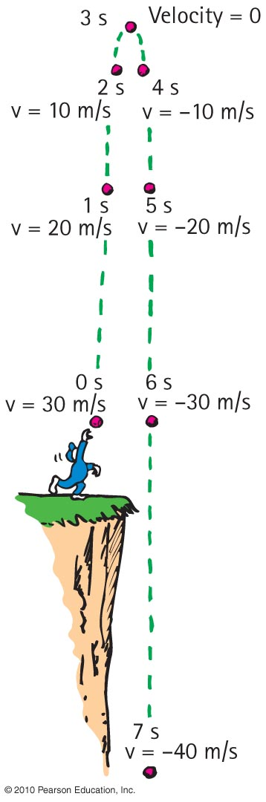
Chapter 3- Problem (2)
A ball is tossed with enough speed straight up so that it is in the air several seconds.
What is the velocity of the ball when it reaches its highest point?

Slide 30
Chapter 3- Problem (2)
A ball is tossed with enough speed straight up so that it is in the air several seconds.
What is the velocity of the ball when it reaches its highest point?
When it reaches its highest point the velocity
V =0
(b) What is its velocity 1 s before it reaches its highest point?
(c) What is the change in its velocity during this 1-s interval?

Slide 31
Chapter 3 – Problem(2)
2. A ball is tossed with enough speed straight up so that it is in the air several seconds.
(b) What is its velocity 1 s before it reaches its highest point?
V = g t = 10 m/s² x 1s = 10 m/s Up
(c) What is the change in its velocity during this 1-s interval?

Slide 32
Chapter 3- Problem (2)
A ball is tossed with enough speed straight up so that it is in the air several seconds.
(b) What is its velocity 1 s before it reaches its highest point?
V = g t = 10 m/s² x 1s = 10 m/s Up
(c) What is the change in its velocity during this 1-s interval?
To reach a velocity of 0 the change must be
-10 m/s or 10 m/s Down, or
Change in velocity = V_{final} – V_{initial} = 0 – 10m/s = 10m/s

Slide 33
Chapter 3- Problem (2)
(d) What is its velocity 1 s after it reaches its highest point?
The same as if it was dropped from it’s highest point V = g t = 10 m/s² x 1s = 10 m/s Down
(e) What is the change in velocity during this 1-s interval?
Again the change in velocity is = V_{final} – V_{initial}
V(1s) – V(0) = 10 m/s – 0 = 10 m/s Down
(f) What is the change in velocity during the 2-s interval?
V = g t = 10 m/s² x 2s = 20 m/s Down
(g) What is the acceleration of the ball during any of these time intervals and at the moment the ball has zero velocity?
In the case of free fall it’s always 10 m/s

Slide 34
Chapter 3- Problem (4)
A car takes 10 s to go from v = 0 m/s to v = 25 m/s at constant acceleration. Find the distance traveled.
Hint: use the equation d = 1/2 at²
To determine d you must first compute the acceleration.
a = (v_{final} – v_{initial} )/ (t_{final} – t_{initial}) = (25m/s – 0) / (10s – 0) = 25/10 m/s².
a = 2.5 m/s².
Then d = ½ (2.5m/s²) (10s)² = 1.25 m/s² x 100s² = 125 m

Slide 35
Chapter 3 – Problem (6)
A dart leaves the barrel of a blowgun at a speed v. The length of the blowgun barrel is L. Assume that the acceleration of the dart in the barrel is uniform.
Show that the dart moves inside the barrel for a time of t = 2L/v
Note that v = a t or a = v/t.
Since d = ½ a t², substituting v/t and d = L into the equation for distance we have L = ½( v/t) t² or L = ½v t.
Solving for time, we have t = 2L/v
If the dart's exit speed is 15.0 m/s and the length of the blowgun is 1.4 m, show that the time the dart is in the barrel is 0.19 s.
Since t = 2L/v = 2 (1.4 m) / 15 m/s = 2.8 / 15 = 0.19s

Slide 36
Homework
Read Chapter 3 in detail.
(2) Do Ranking # 1
(3) Do Exercises 13 , 32
(3) Do Problems 1, 3
Homework due: May 23

